Slide 1
BOSH 101
How to create a BOSH Release

Slide 2
What is BOSH
Bosh unifies:
Release engineering
Deployment
Lifecycle Management
Of small and large scale cloud software
Notes:
BOSH is a self referencing acronym. BOSH stands for the BOSH Outer shell, which in itself is BOSH. Now you know that it doesn’t actually stand for anything in particular. I’m sure you could come up with some ideas though if you like as well.

Slide 3
Why should we use BOSH?
Bosh can provision and deploy software over 100s of VMs reliably, with repeatability and auto-resurrection of failed VM’s to last known state.
It also:
Performs monitoring
Failure recovery
Software updates
With zero to minimal downtime

Slide 4
What problems is BOSH solving for me?
BOSH addresses all parts of versioning, packaging, and deploying the software in a reproducible manner, normally achieved using a combination of tools
Specifically, BOSH addresses the 4 principles of modern Release Engineering ==>
Identifiability
Reproducibility
Consistency
Agility
Notes:
BOSH was purposefully constructed to address the four principles of modern Release Engineering in the following ways:

Slide 5
What problems is BOSH solving for me? (contd.)
Identifiability
Identify all the source, tools, environment and the other components that make up a particular release
BOSH has a concept of a software release which packages up all related
source code
binary assets
configuration etc.
This allows users to
easily track contents of a particular release.
BOSH provides a way to capture all Operating System dependencies as one image.

Slide 6
What problems is BOSH solving for me? (contd.)
Reproducibility
The ability to integrate source, third party components, data, and deployment externals of a software system in order to guarantee operational stability
BOSH tool chain provides
a centralized server that manages software releases
Operating System images
persistent data
and system configuration
...giving you a clear and simple way of operating a deployed system.

Slide 7
What problems is BOSH solving for me? (contd.)
Consistency
The mission to provide a stable framework for development, deployment, audit, and accountability for software components
BOSH software releases workflows are used
throughout the development of the software and
when the system needs to be deployed.
BOSH centralized server allows users to
see and
track changes made to the deployed system.

Slide 8
What problems is BOSH solving for me? (contd.)
Agility
The ongoing research into what are the repercussions of modern software engineering practices on the productivity in the software cycle, i.e. continuous integration
BOSH tool chain integrates well with current best practices of software engineering
like Continuous Delivery
by providing ways to easily
create software releases in an automated way and
to update complex deployed systems with simple commands.

Slide 9
Initialization of a BOSH release
While release deployment, BOSH will place code and resources needed (more on this later)
At /var/vcap
This dir structure is created by BOSH on each of the job VMs
Trivia:
Vcap : A remnant of VMWare days, it stands for VMWare Cloud Application Platform
So: we will soon see:
/var/vcap/jobs
/var/vcap/packages
/var/vcap/src
And
/var/vcap/blobs

Slide 10
BOSH Jobs Stages of a Job
A “job” represents a specific chunk of work that is performed by the BOSH release.
It is common and recommended that a release have multiple jobs, loosely coupled.
The primary goal of a BOSH job is threefold:
-Maximize availability
-Eliminate the need for manual intervention
-Contribute to faster deployments
-When a ‘Start’ is issued
-When processes are running
-When a ‘Stop’ is issued
Pre-start scripts run for all the jobs on the VM in parallel
Job Implementation Best Practices: Scripts must not rely on the order they are run. The agent can decides to run them serially or in parallel.
Notes:
When a start is issued:
Persistent disks are mounted on the VM if configured, and not already mounted
All jobs and their dependent packages are downloaded and placed onto a machine
pre-start scripts run for all jobs on the VM in parallel
(waits for all pre-start scripts to finish)
does not time out
monit start is called for each process in no particular order
each job can specify zero or more processes
times out based on canarywatchtime/updatewatchtime settings
post-start scripts run for all jobs on the VM in parallel
(waits for all post-start scripts to finish)
does not time out
post-deploy scripts run for all jobs on all VMs in parallel
(waits for all post-deploy scripts to finish)
does not time out
Note that scripts should not rely on the order they are run. Agent may decide to run them serially or in parallel.
When Processes are running:
Monit will automatically restart processes that failed their associated checks
a common pattern used is a PID check
When a stop is issued:
monit unmonitor is called for each process
drain scripts run for all jobs on the VM in parallel
(waits for all drain scripts to finish)
does not time out
monit stop is called for each process
times out after 5 minutes as of bosh v258+ on 3302+ stemcells
Persistent disks are unmounted on the VM if configured

Slide 11
Anatomy of a BOSH Job
Pre-start :
Runs before BOSH hands off control to monit
Monit Start :
Start the main process
Write the process PID to a pidfile
Executed as root
Post-Start (Optional)
Custom health checks
Post-Deploy (Optional)
Check the health of a deployment
Monit Stop
Stop the process
Default 30 second timeout
Drain (Optional)
Optional hooks that are run before the job is stopped via monit
If your service must perform some work before being shut down, it is typically performed here
No default timeout
Best Practice Recommendation:
It is recommended that all BOSH jobs be broken up within these guidelines
Notes:
Note: The start script is executed as root. Do not assume you can only break your own process.
Note: If your process cannot start quickly, consider moving long-running tasks to pre-start or post-start.
Start:
Note for Windows Releases: The Windows BOSH Agent does not use monit and manages starting the script directly. If your pre-start and post-start scripts have been written following the guidance in this document, the Agent will be able to start your process correctly.
Stop:
Note for Windows Releases: The Windows BOSH Agent does not use monit and manages starting the script directly. If your pre-start and post-start scripts have been written following the guidance in this document, the Agent will be able to stop your process correctly.

Slide 12
Review
What are the major components of a Job?
Where are properties defined?
There is usually at least one ERB template. What is it?
Name a reason why ERB templates are needed.

Slide 13
Make a Dependency Graph
There are 2 kinds of dependencies in a BOSH Release:
Runtime dependency
Where a job depends on a package at runtime
Compile-time dependency
Where a job depends on a package at compile-time
Rules for dependencies:
Jobs can never depend on other jobs
Jobs can depend on packages
Packages may depend on other packages

Slide 14
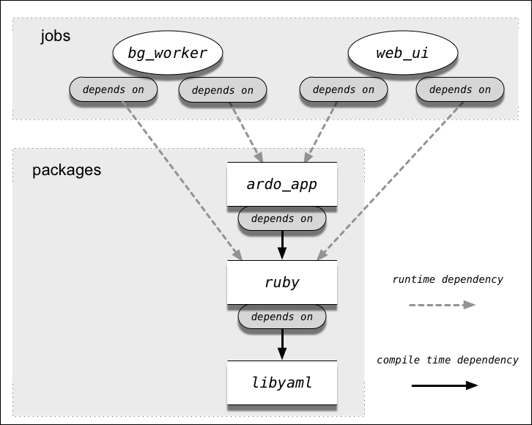
Exercise: Sample Dependency Graph

Slide 15
Exercise: Dependency Graph for PostGreSQL
Jobs
my_pg_server
depends on
Packages
my_pg_package

Slide 16
BOSH Packages
Packages give BOSH the information needed to prepare the binaries and dependencies for the job
Best Practice: Put each dependency in a separate package for maximum reusability, along with a clear, modular structure

Slide 17
Optional: BOSH Blobs
Depending on your release, you will likely use a source code repository
Bosh releases often use tar files and binaries, also known as blobs
Checking blobs into source control is not recommended, especially if the binaries are large
The BOSH blobs serves precisely this purpose
BOSH lets you avoid checking blobs into a repository by using local copies of blobs for dev releases, and blobs from the blobstore for final releases

Slide 18
Let’s review
What is BOSH?
Why BOSH?
What is the anatomy of a BOSH release?
How to create a BOSH release?
Hand-On Lab to create a PostGreSQL Bosh release
BOSH release dependency graph creation
Best Practice guidelines
Deploy and interact with the release

